Slide 1
Build an Inexpensive
Retro Gaming Machine in Under an Hour
with Tim Ellis (44) & Maezie Ellis (13)

Slide 2
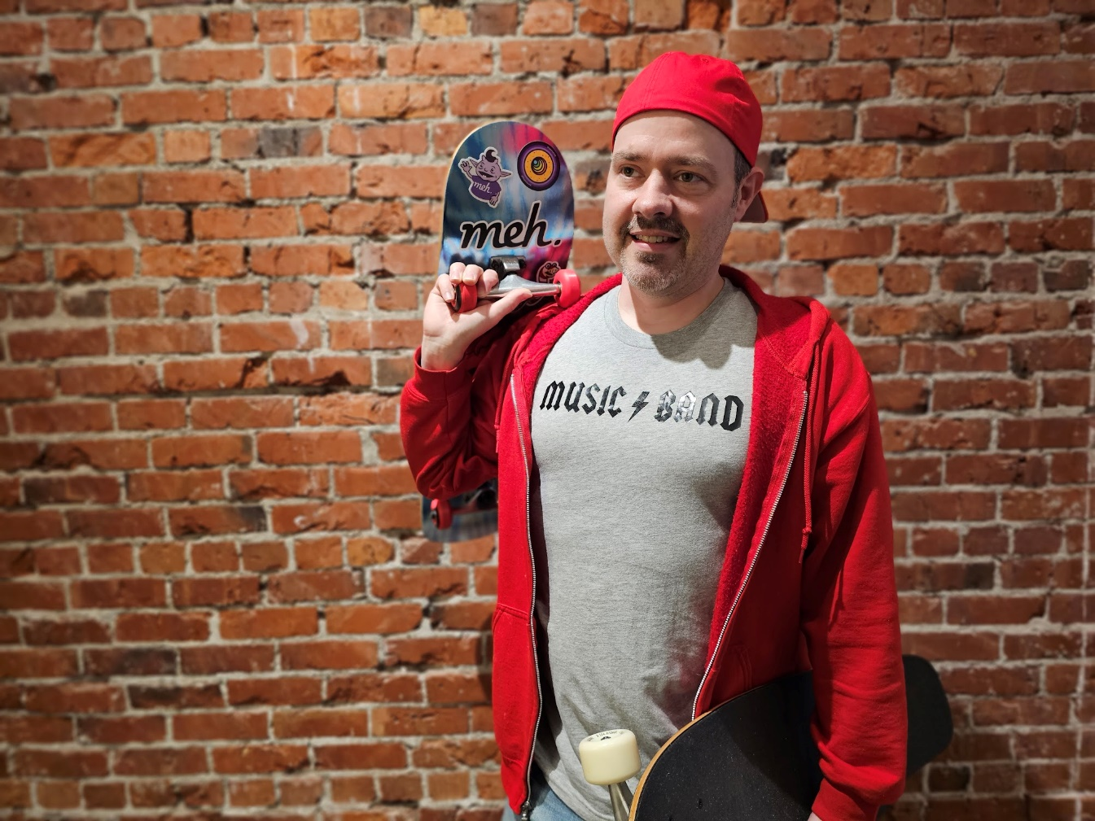
Who is Tim?
@The_Tim@mastodon.social
gamer since 198X
sci-fi comedy
podcaster
How do you do,
fellow kids?

Slide 3

Who is Maezie?
gamer since 201X
8th grader
cool kid

Slide 4
What You’ll Need
Raspberry Pi
MicroSD card
2A USB power supply + MicroUSB cable
HDMI cable
your TV / monitor of choice
(almost) any USB game controller
your retro game ROMs of choice
good to have for setup: USB keyboard
Notes:
Talk about versions of Raspberry Pi.
I’m using the Raspberry Pi 3 B+
Versions 3 and up have WiFi and Bluetooth (which means you can use Bluetooth controllers, even Wiimotes)
You can technically install RetroPie on a 4GB card but if you want to have many games you’ll want to use at least a 32GB card.
The USB keyboard could come in handy for things like configuring your WiFi during setup, but you won’t need it once everything is configured.

Slide 5

Where to get your Pi
RaspberryPi.org lists the legit retailers
Notes:
https://www.raspberrypi.org/products/

Slide 6
Where to get your Pi
DO NOT buy Raspberry Pi on Amazon.
Notes:
Amazon sellers mark it up.

Slide 7
Raspberry Pi Versions
Version | 512MB | 1GB | 2GB | 4GB | 8GB | Notes
Pi Zero | $10 |  |  |  |  | no WiFi, no Bluetooth
Pi Zero W | $15 |  |  |  |  | micro connectors
Pi Zero 2W | $15 |  |  |  |  | micro connectors
Pi 1 Model B+ | $30 |  |  |  |  | no WiFi, no Bluetooth
Pi 3 Model A+ | $35 |  |  |  |  | no ethernet, 1 USB
Pi 3 Model B |  | $35
Pi 3 Model B+ |  | $35
Pi 4 Model B |  | $35 | $45 | $55 | $75 | 4 & 5 use USB-C power & Micro HDMI
Pi 5 |  |  | $50 | $60 | $80 | no RetroPie support
Notes:
Watch out! Unscrupulous sellers are out there with marked-up Pis or unnecessary bundles, even when you can get one at retail price.

Slide 8
Raspberry Pi Versions
Pi 3 plays up to PS1 games
Pi 4 plays up to most N64 & Dreamcast
Pi 5 plays up to N64, Dreamcast, GameCube, Wii, & some PS2
  BUT! Pi 5 is not yet officially supported by RetroPie so you’re on your own.

Slide 9
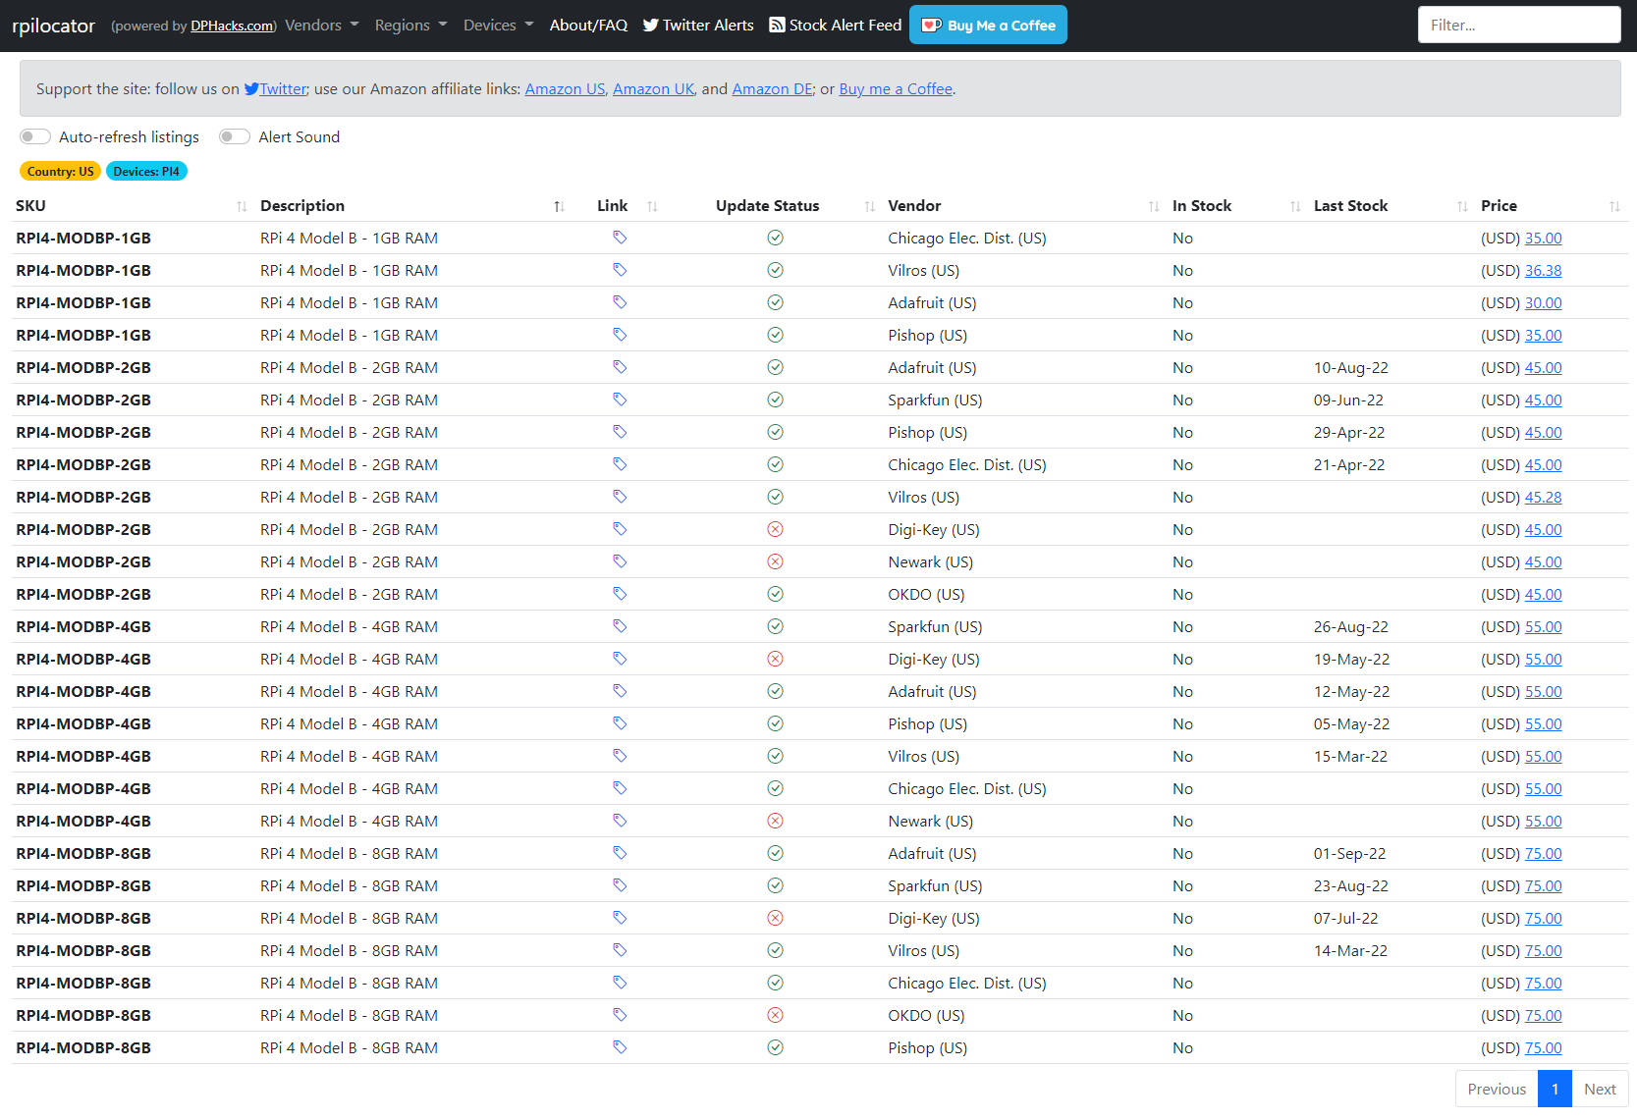
if Pi are sold out:
rpilocator.com
Notes:
rPilocator is a website that automatically checks stock at all the legitimate retailers, they also have a Twitter account (same as their domain name) that you can use to get instant stock alerts.

Slide 10
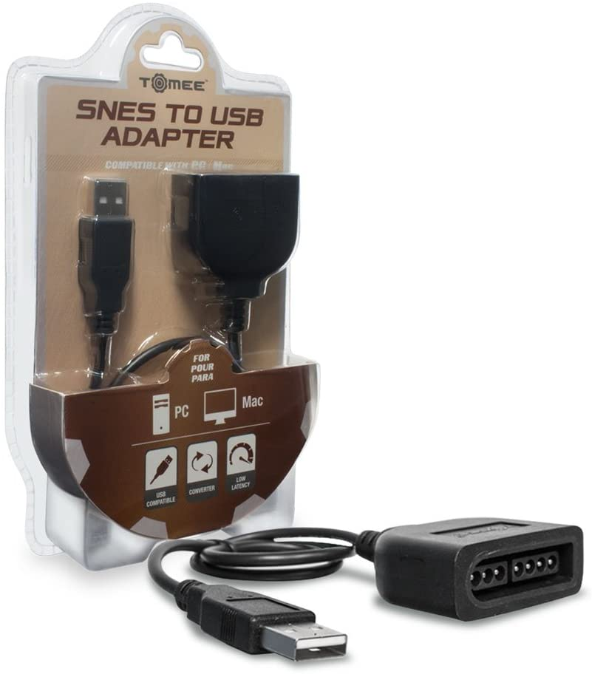
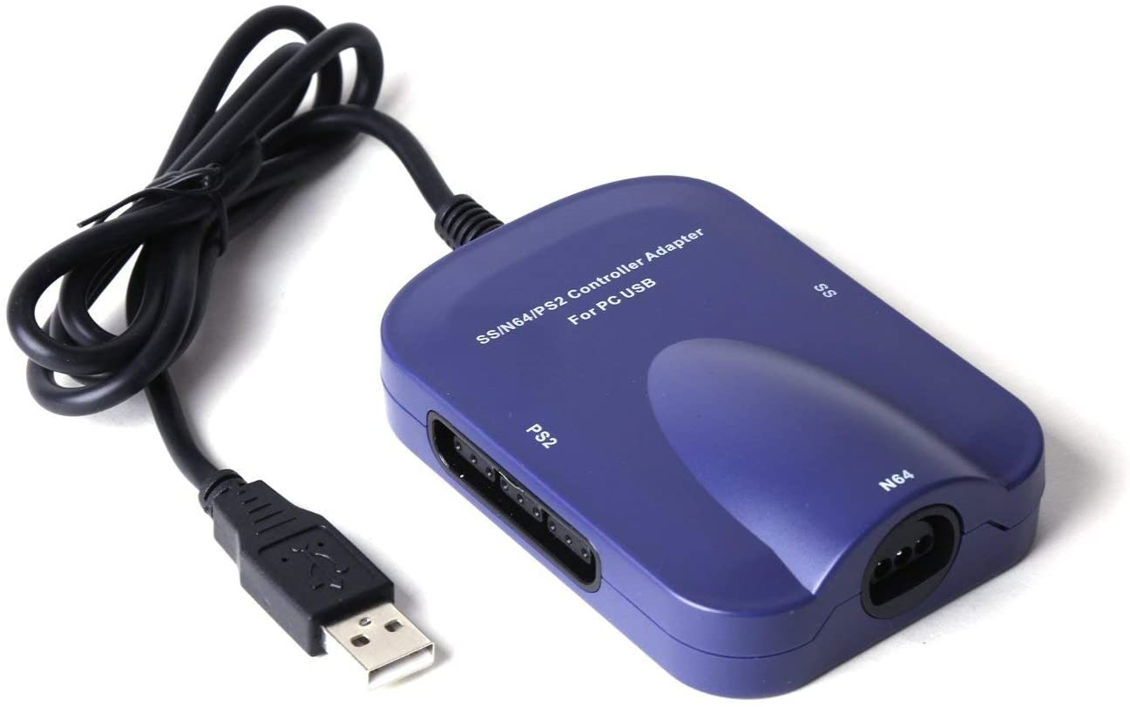
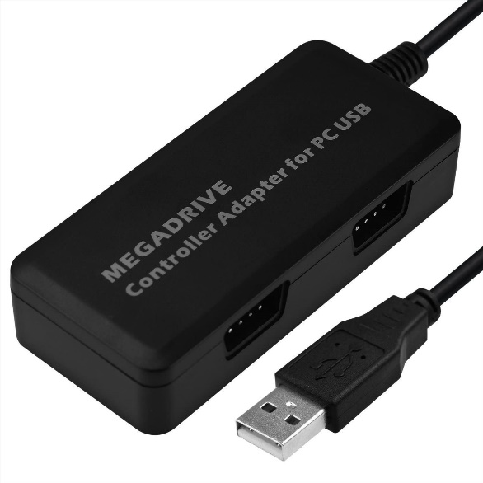
Accessories
Vintage controller USB adapters
  getting harder to find (e.g. eBay)
  Tomee & Mayflash are good brands
Notes:
These are unfortunately getting a lot harder to find.

Slide 11
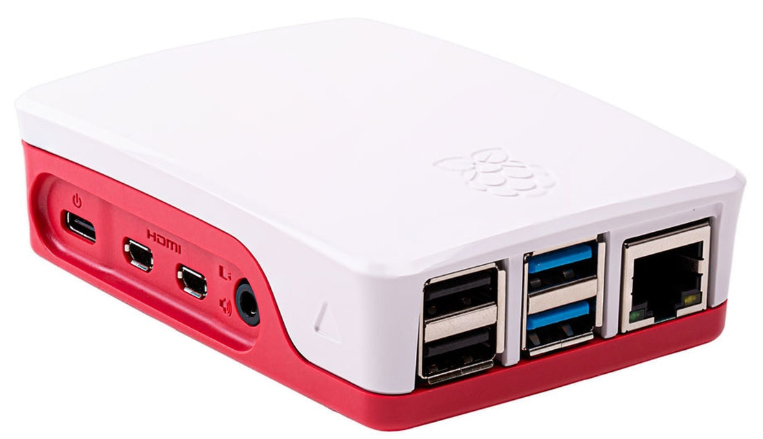
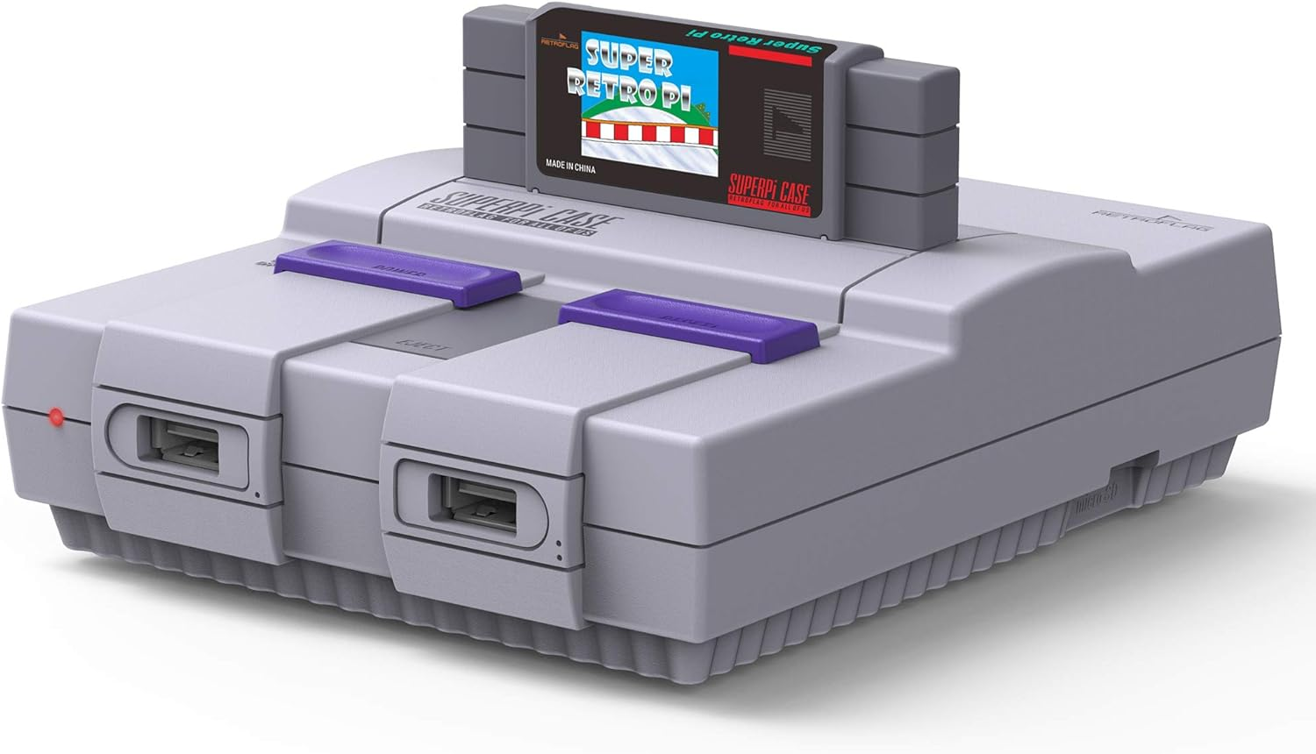
Accessories, Cont.
Raspberry Pi cases: $5 and up
$5 official Pi 4 case
$13 fun case
Notes:
Official case: https://www.raspberrypi.org/products/raspberry-pi-4-case/
Super NES-like case: https://www.amazon.com/Retroflag-Raspberry-superpi-Shutdown-Version/dp/B07W5L95KK/
Another SNES: https://www.amazon.com/Retroflag-Functional-Controller-Raspberry-Heatsink/dp/B07HF2ZYLR/

Slide 12
Steps
Download RetroPie
Flash to SD Card
Boot / setup controller(s)
Set up Internet (optional)
Set up USB stick on PC
Put USB stick into Pi
Put ROMs on USB stick
Put USB stick into Pi
Restart Emulation Station
Play games!
Notes:
Yes this is really all there is to it!

Slide 13
1. Download RetroPie
time: 5 – ??? minutes
(depends on your Internet speed)
Notes:
https://retropie.org.uk/download/
https://retropie.org.uk/docs/First-Installation/

Slide 14
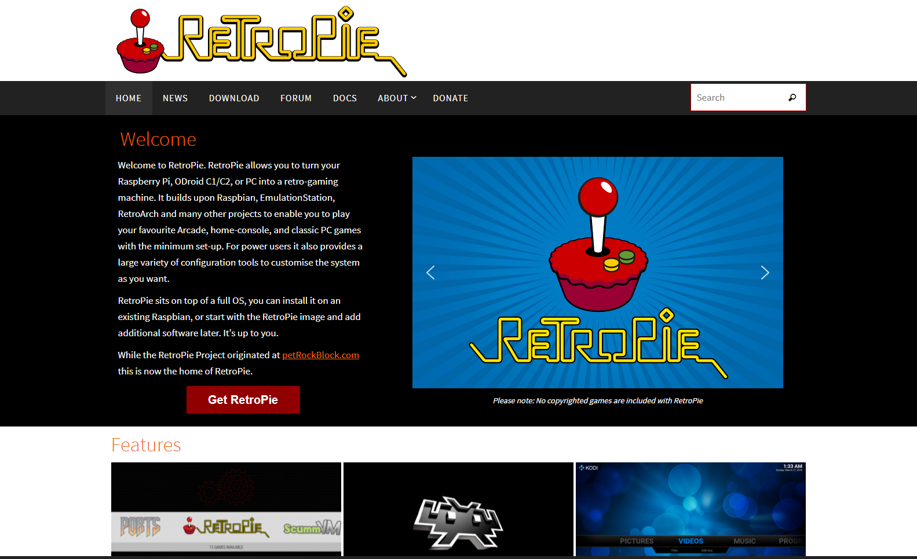
retropie.org.uk
Notes:
Go to https://retropie.org.uk/ to get the operating system that you’ll be installing on your Pi.

Slide 15
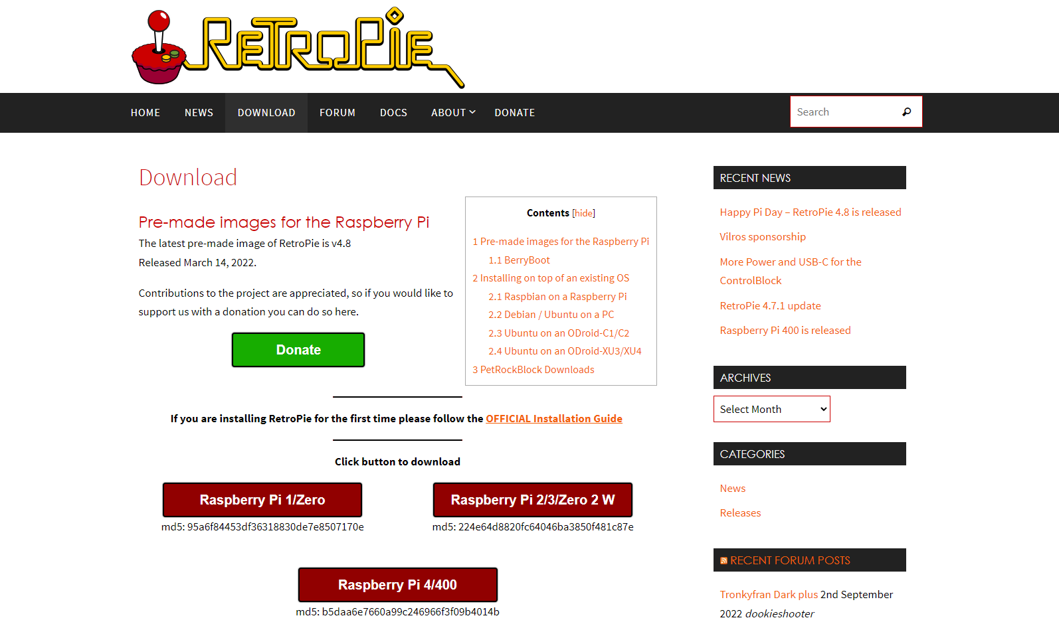
retropie.org.uk
Notes:
Pay attention because there are multiple versions of the image file, depending on which Raspberry Pi you have. Be sure to get the appropriate version for the Raspberry Pi you’re using.

Slide 16
RetroPie Emulation
3do
Amiga
Amstrad CPC
Apple II
Atari 2600
Atari 5200
Atari 7800
Atari Jaguar
Atari Lynx
Atari ST
Colecovision
CoCo
Commodore 64
Dragon 32
Dreamcast
GameCube*
Game Gear
Game Boy
Game Boy Color
Game Boy Advance
Intellivision
Macintosh
Mame
Master System
MSX
Neo Geo
Neo Geo Pocket
Neo Geo Pocket Color
Nintendo 64
Nintendo DS
Nintendo Entertainment System
Oric
PC
PC Engine / TurboGrafx16
Playstation 1
Playstation 2*
PSP
SAM coupé
Sega 32X
Sega CD
Sega Genesis / Megadrive
Sega SG-1000
Super Nintendo
TI-99/4A
TRS-80
Vectrex
Videopac / Odyssey 2
Virtual Boy
Wii*
Wonderwan
Wonderwan Color
ZX Spectrum
* GameCube, Wii, & PS2 will not work on Raspberry Pi 4 & below
Notes:
We’re using RetroPie because it is plug-and-play, and it supports 50+ systems out of the box.

Slide 17
2. Flash to SD Card
time: ~20 minutes
Notes:
https://etcher.io/ is the best tool, works on Windows, Mac, Linux
This may take more or less time depending on how big your SD card is…
The ETA is unreliable, ignore it.
128GB card ~10 minutes flash, ~10 minutes verify

Slide 18
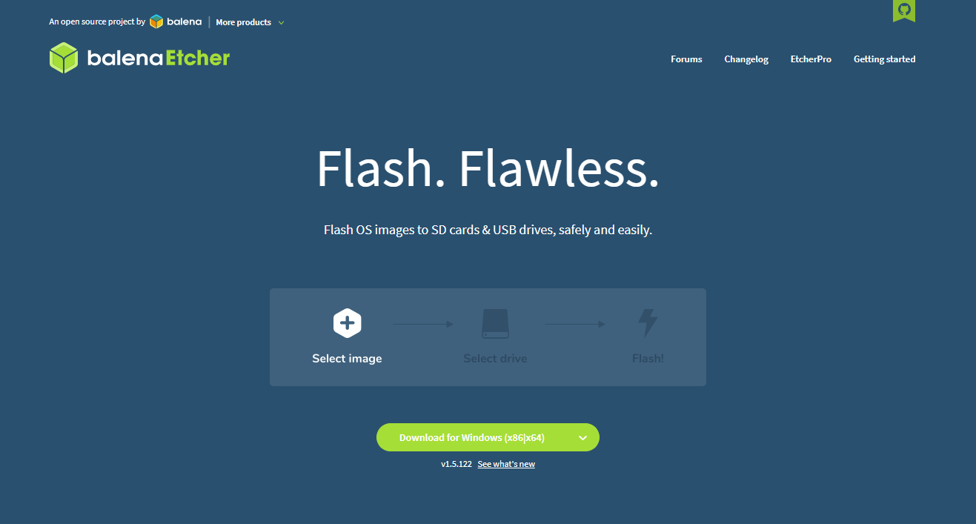
etcher.io
Notes:
https://etcher.io/ is the best tool, works on Windows, Mac, Linux
This may take more or less time depending on how big your SD card is…
The ETA is unreliable, ignore it.
128GB card ~10 minutes flash, ~10 minutes verify

Slide 19
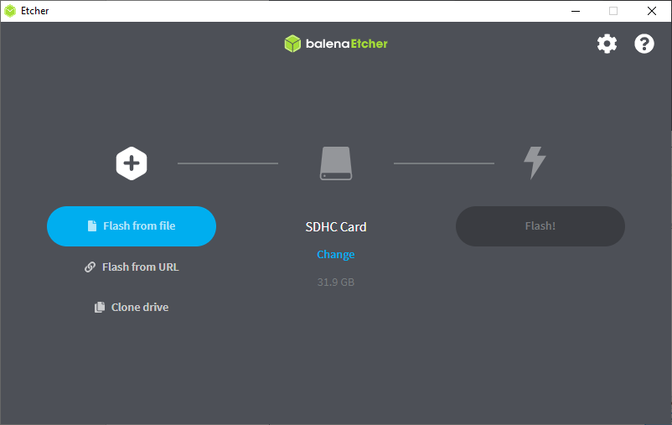
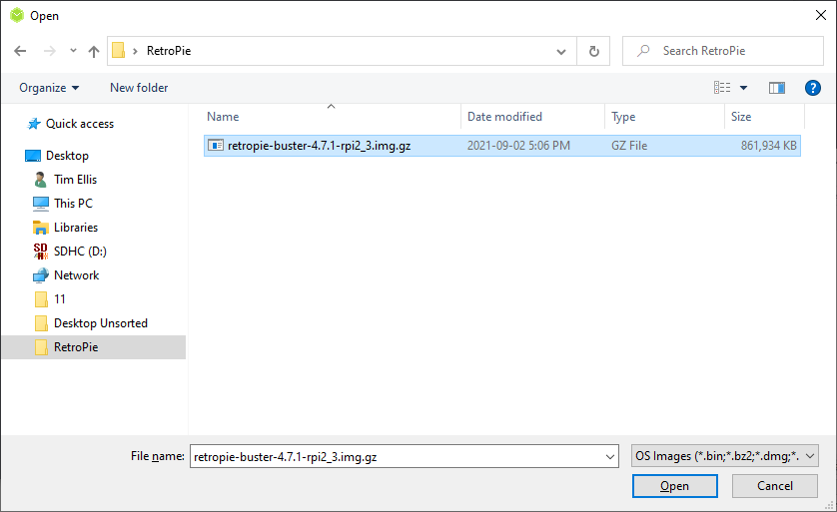

Slide 20
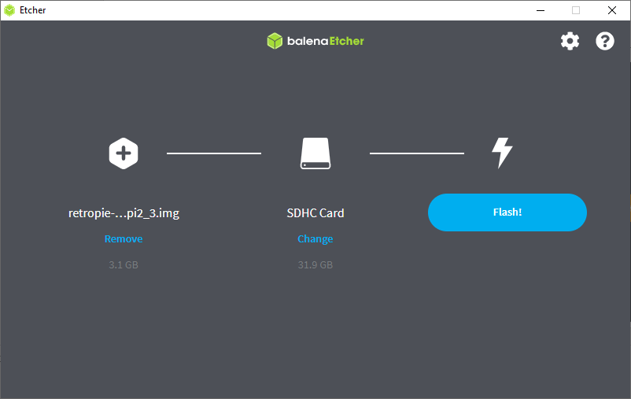
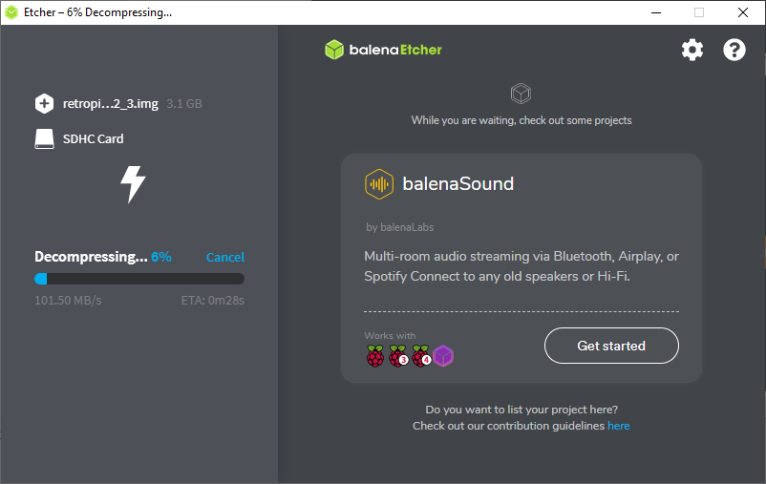

Slide 21
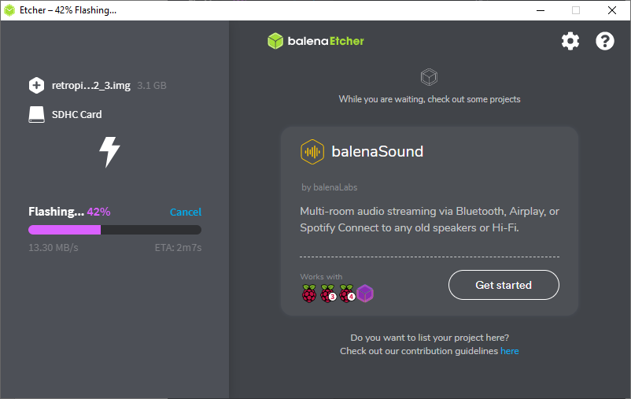
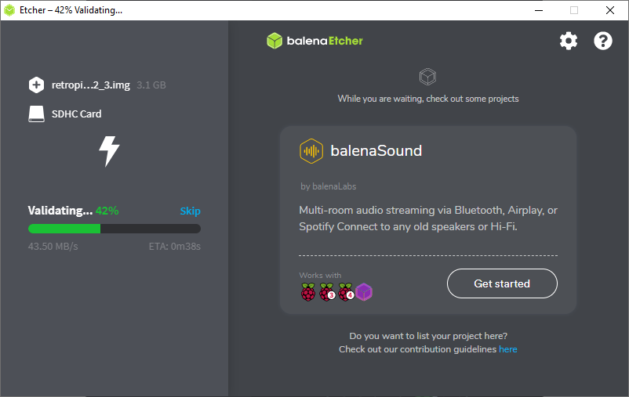

Slide 22
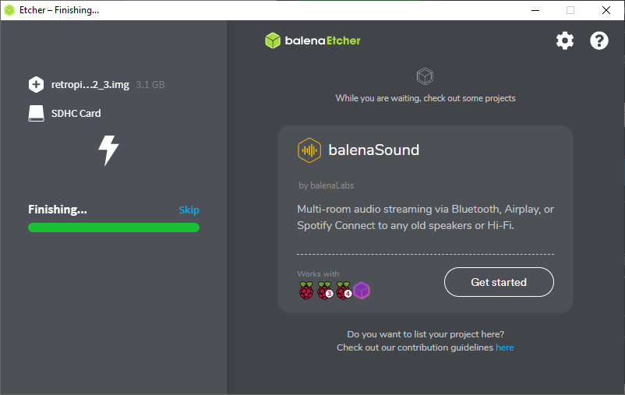
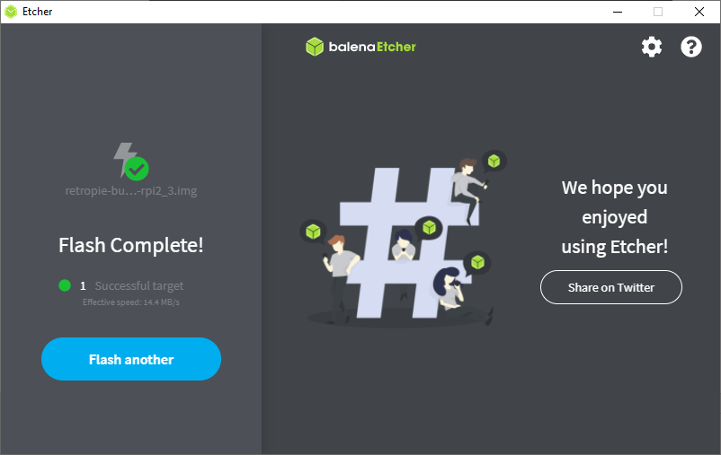

Slide 23
3. Boot / setup controller(s)
time: 5 minutes
Notes:
It will take 1-2 minute for the first input screen to come up.
Controller config: press the buttons on your controller at the prompts.
If you’re using a controller without analog or some of the buttons, just hold a button you’ve already assigned to skip to the next one.

Slide 24
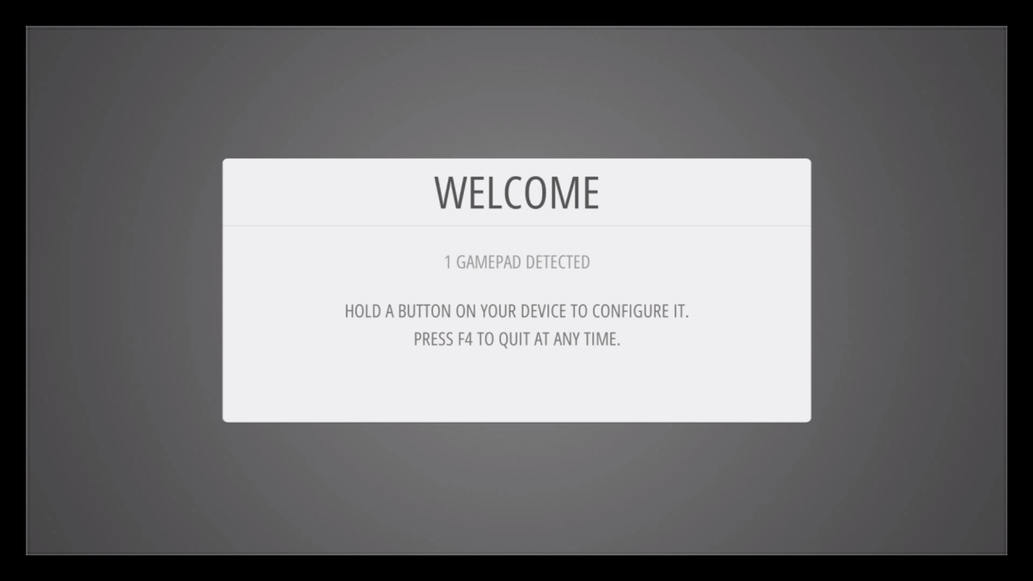
Notes:
screenshot via https://retropie.org.uk/docs/First-Installation/

Slide 25
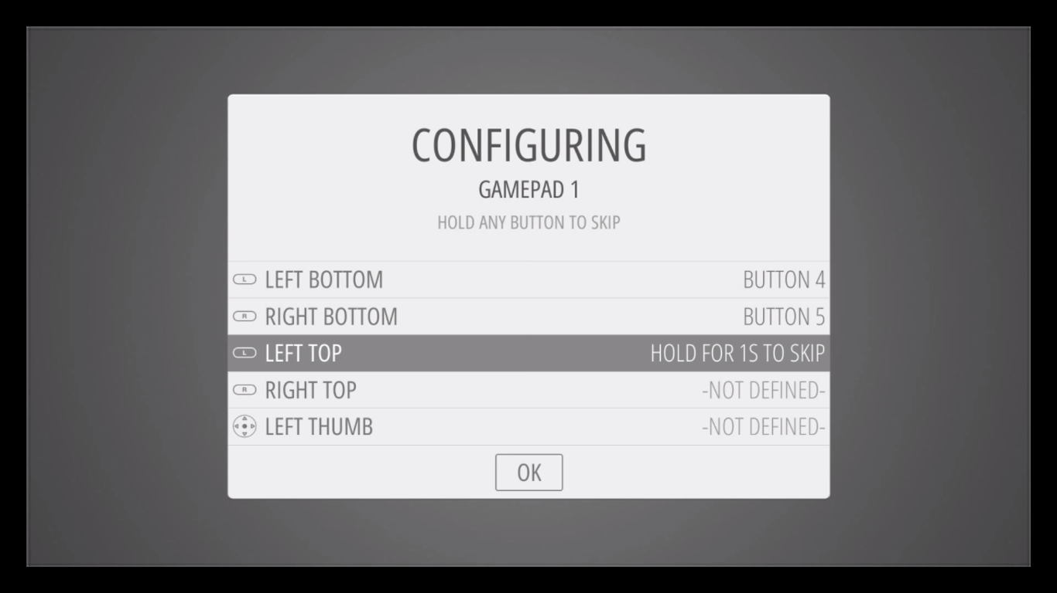
Notes:
Press the buttons on your controller at the prompts.
If you’re using a controller without analog or some of the buttons, just hold a button you’ve already assigned to skip to the next one.
screenshot via https://retropie.org.uk/docs/First-Installation/

Slide 26
Hotkeys?!?
Hotkeys | Action
Select+Start | Exit
Select+Right Shoulder | Save
Select+Left Shoulder | Load
Select+Right | Input State Slot Increase
Select+Left | Input State Slot Decrease
Select+X | RGUI Menu
Select+B | Reset
Notes:
Hotkey is the one function you can double-up a button on your controller. Typically you’ll use the “SELECT” button.
They let you quickly save/load states, exit, reset, etc.
more info: https://retropie.org.uk/docs/First-Installation/

Slide 27
4. Set up Internet (optional)
time: 5 minutes
Notes:
If you have a Raspberry Pi 3 (or newer) you can use WiFi
You’ll have to set the WiFi country first, then you can connect to your WiFi network
For older Raspberry Pi you’ll need to use wired or a USB WiFi dongle

Slide 28
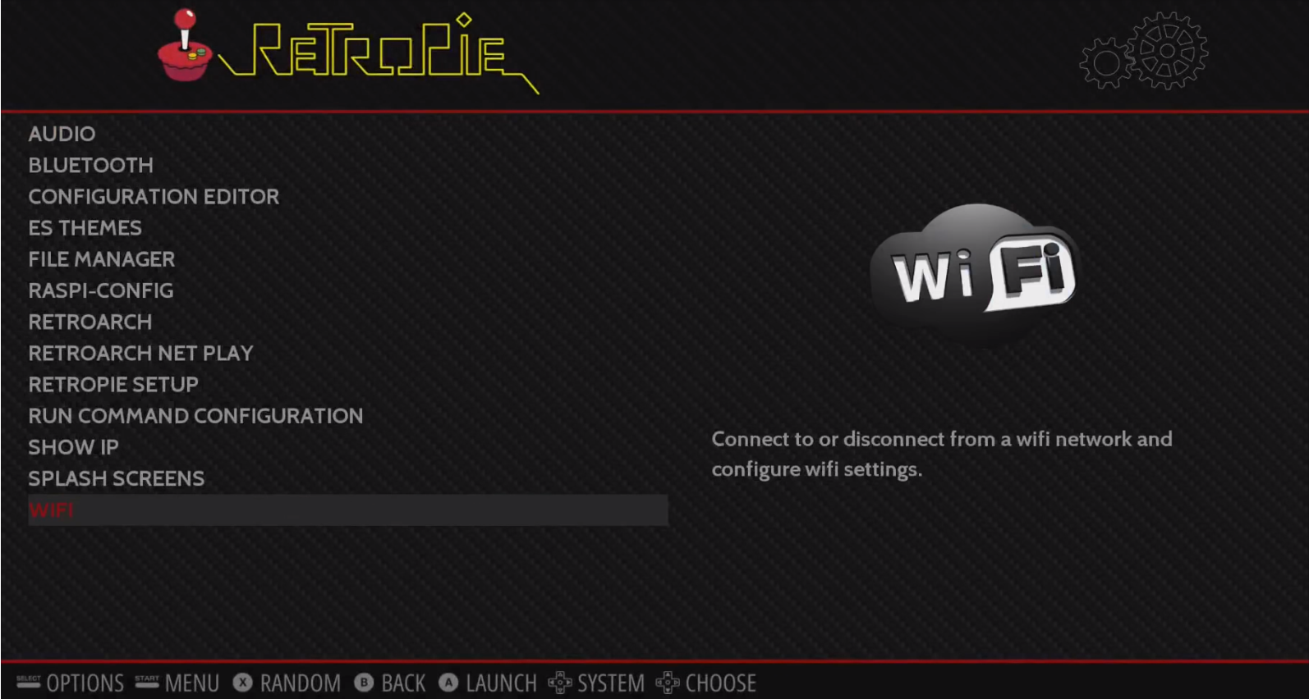
Notes:
On the main screen all you’ll have is RetroPie configuration as an option. Press “A” to select that, then choose “WiFi” from the menu.

Slide 29
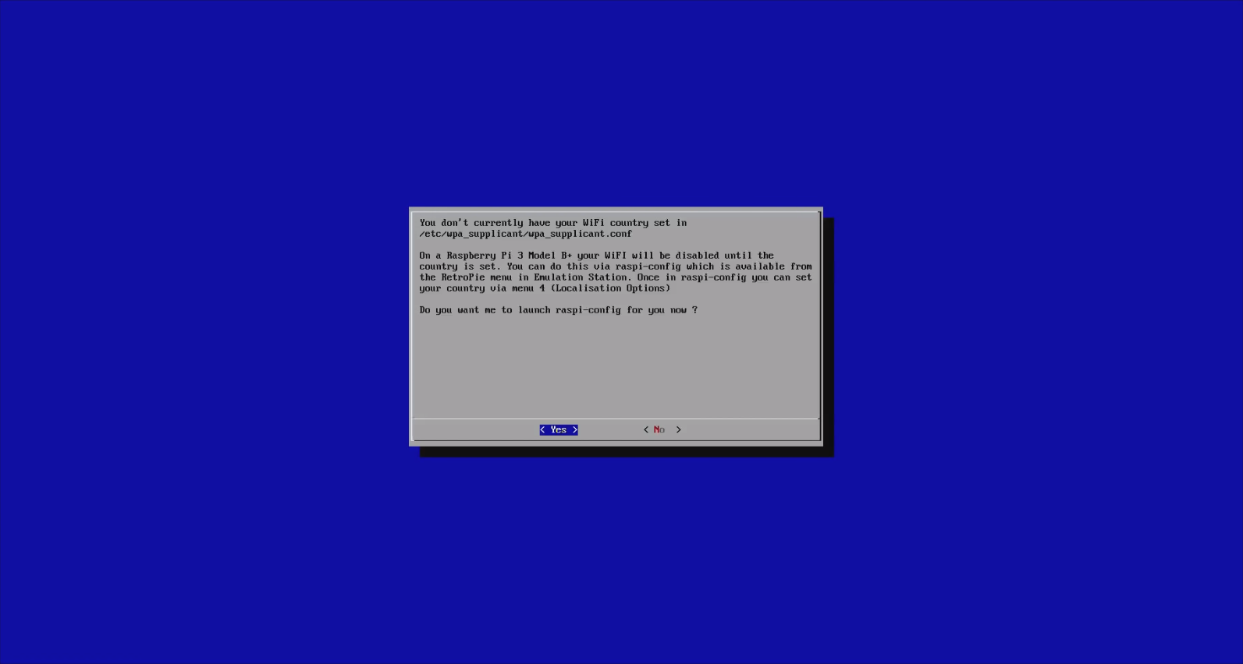
Notes:
It will ask you to set a WiFi country, choose Yes.

Slide 30
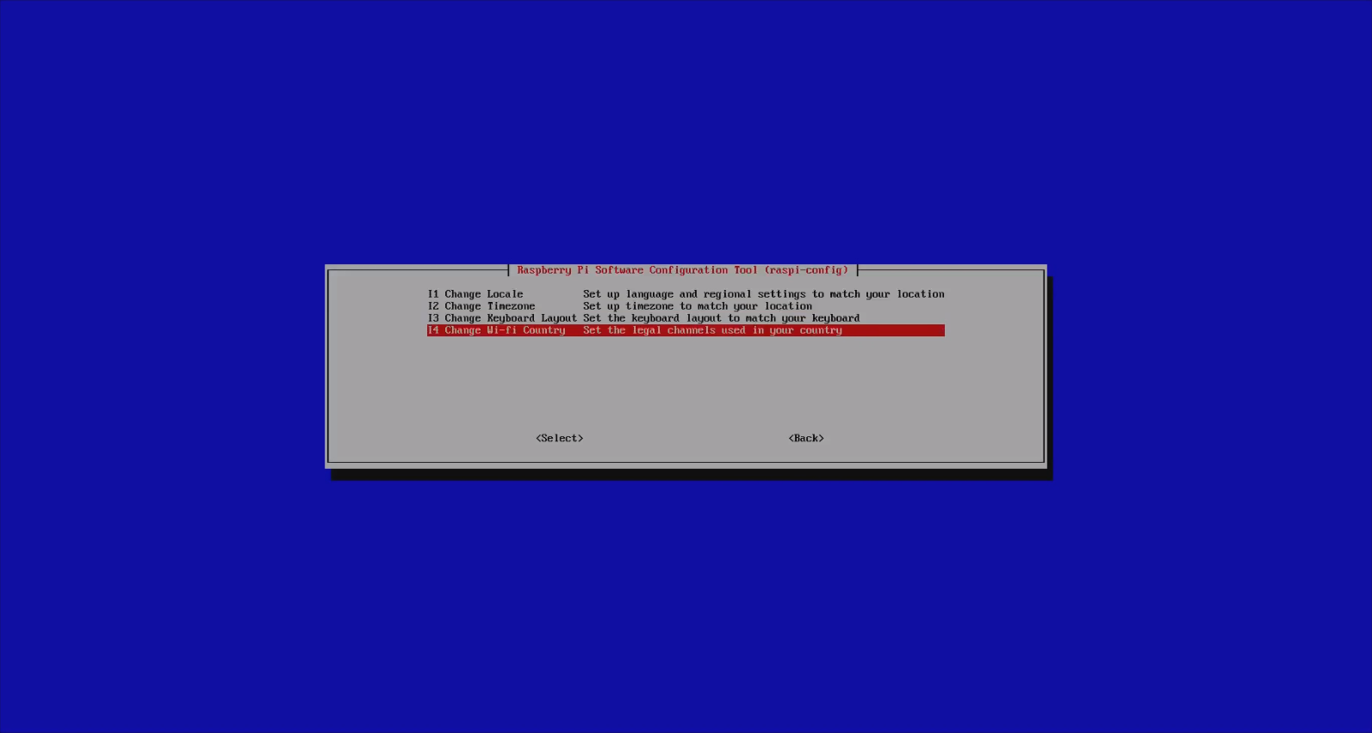
Notes:
Scroll to the option to “Change Wi-Fi Country” and select that, then choose your appropriate country from the list.

Slide 31
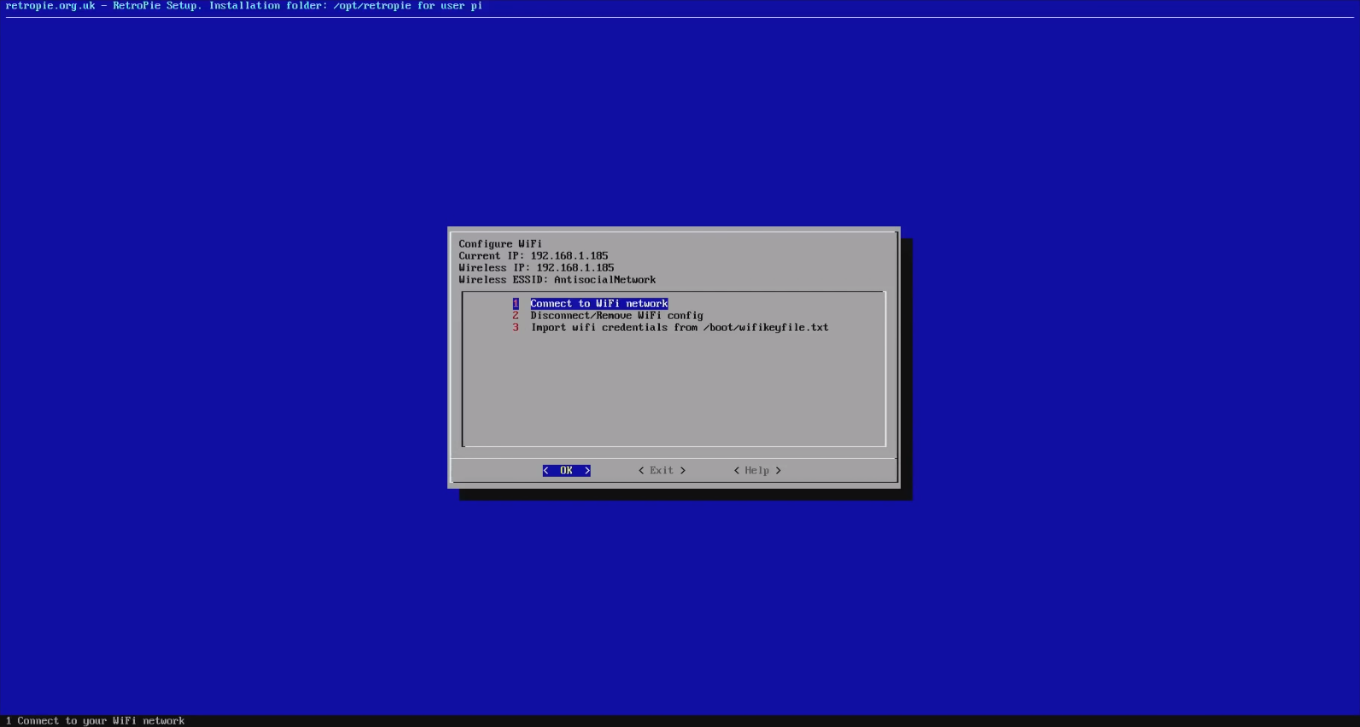
Notes:
Now you can connect to your WiFi network.

Slide 32
5. Set up USB stick on PC
time: 1 minute
Notes:
Format your USB stick to FAT or FAT32
Add a folder to the root directory called “retropie”
Eject it.

Slide 33
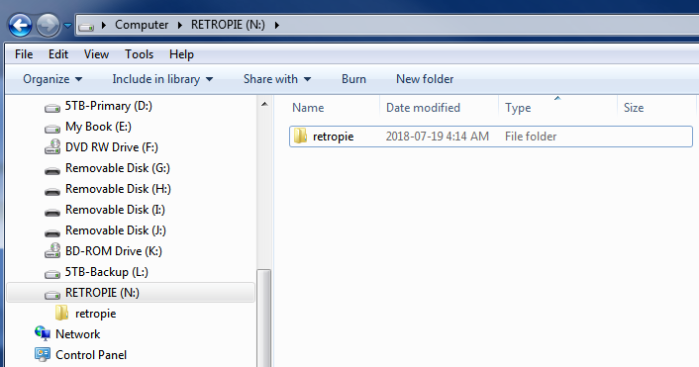
Notes:
Just create an empty folder called “retropie.”

Slide 34
6. Put USB stick into Pi
time: 1-2 minutes
Notes:
If it has a light it will blink for a while as RetroPie sets up the folders for your ROMs.
Wait for the light to stop blinking, or if there’s no light, just wait a minute or so, then you can pull it out.

Slide 35
7. Put ROMs on
USB stick
time: 1-5 minutes
(depends on number of ROMs)
Notes:
RetroPie should have automatically created folders for the various systems, e.g. NES, SNES, Genesis, etc.
Just drop your 100% legally-acquired ROMs into the appropriate folders and remove the stick from the PC.
Do not @ me to ask about ROMs or argue about whether or not ripping your own ROMs from cartridge is legal.

Slide 36
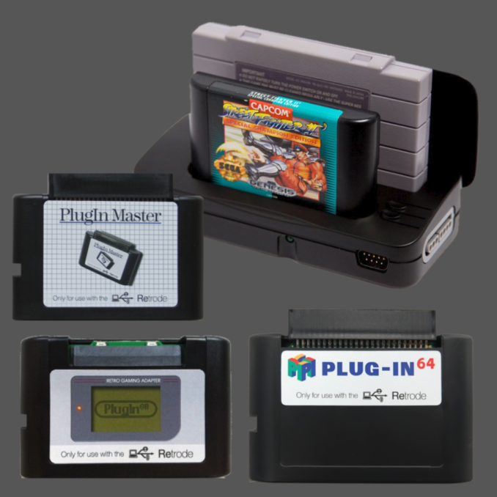
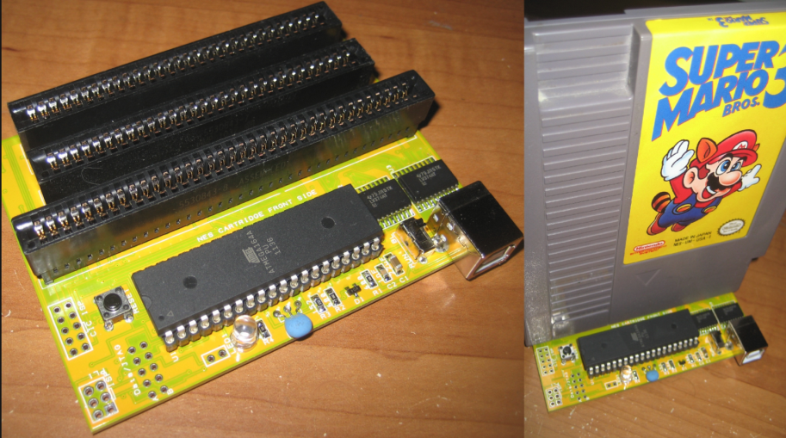
DIY ROMs
Retrode2 + Plugins
SNES
N64
Game Boy
Game Boy Color
Game Boy Advance
Sega Genesis
Master System
Kazzo
NES
Famicom
Notes:
You can rip your own ROMs! Custom hardware is available that will allow you to download the ROMs from your cartridges to your PC.

Slide 37
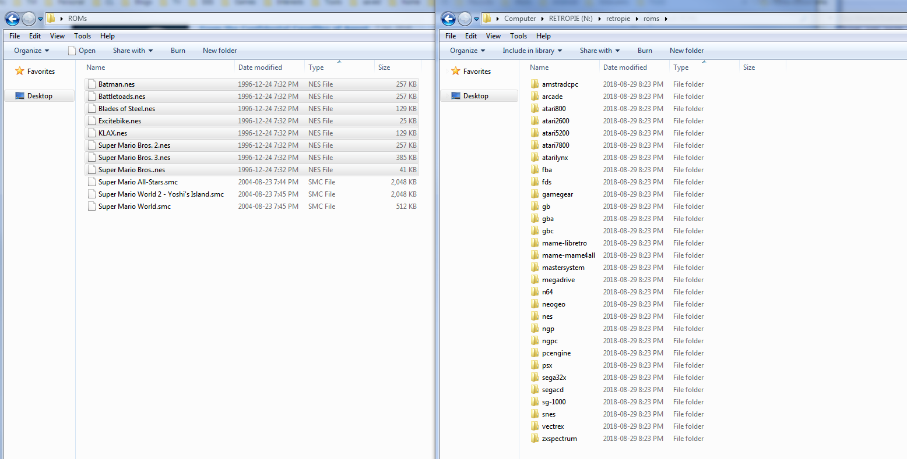
Notes:
It is worth noting that it is also possible to transfer ROMs via network, once you’ve set up WiFi or connected to ethernet.

Slide 38
8. Put USB stick into Pi
time: 1-10 minutes
(depends on number of ROMs)
Notes:
Seriously, just stick it on in there.
ROMs placed in their appropriate folders will copy to your Pi automatically.

Slide 39
9. Restart
Emulation Station
time: 1 minute
Notes:
Press [Start] to open the Main Menu
Choose “Quit”
Choose “Restart EmulationStation”
“Really Restart?” “Yes”
Wait for it to re-boot

Slide 40
10. Play games!
time: FOREVER
Notes:
If you did everything right, the systems that you added ROMs for will appear on the main menu, just select the system you want to play, choose your game, and play!

Slide 41
Questions?
download these slides at ellis.fyi/pax2024
visit PAXWest24.com/PanelSurveys
& tell PAX how great our panel was!
Notes:
Detailed info can be found at https://retropie.org.uk/docs/First-Installation/
They also have a great walkthrough video! https://www.youtube.com/watch?v=E1sbnPZ_A8w
You can also see the video version of this presentation from PAX Online 2020 here: https://www.youtube.com/watch?v=0HJgzuPzv3Y

